Slide 1
Wireless network and IoT security
Lecture 11: Wi-Fi Protected Access 2 (WPA2)
Instructor: Kui Ren

Slide 2
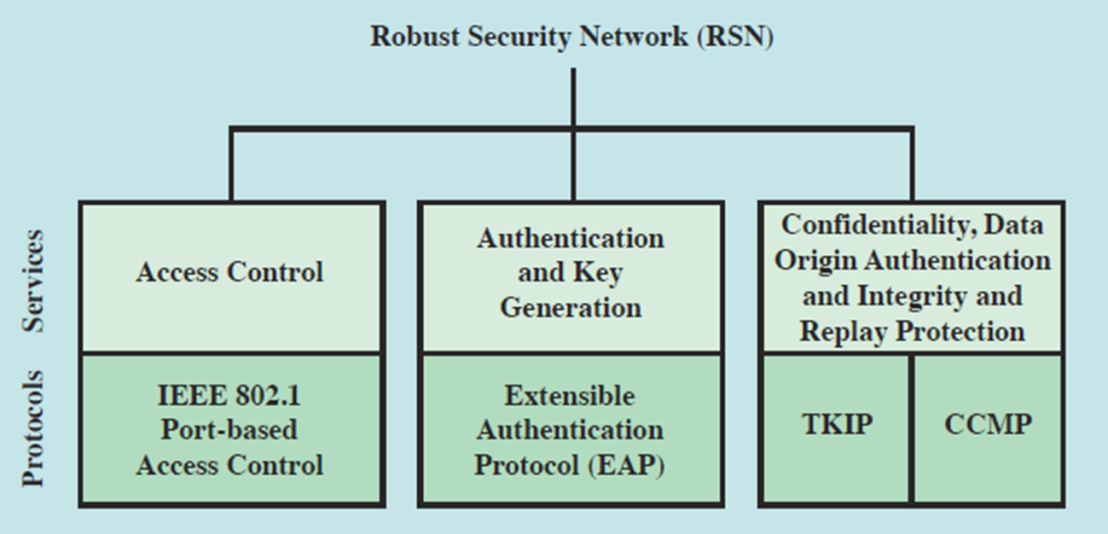
Wi-Fi Protected Access 2 (WPA2)
Based on the IEEE 802.11i standard.
The primary enhancement over WPA is the use of the AES-based CCMP
The final form of the 802.11i standard is RSN (Robust Security Network)

Slide 3
Wi-Fi Protected Access 2 (WPA2)
The Personal mode uses a PSK (Pre-Shared Key) and doesn't require a separate authentication of users.
The Enterprise mode requires the users to be separately authenticated by using the Extended EAP (Extensible Authentication Protocol).
WPA2 Versions
Personal
Enterprise

Slide 4
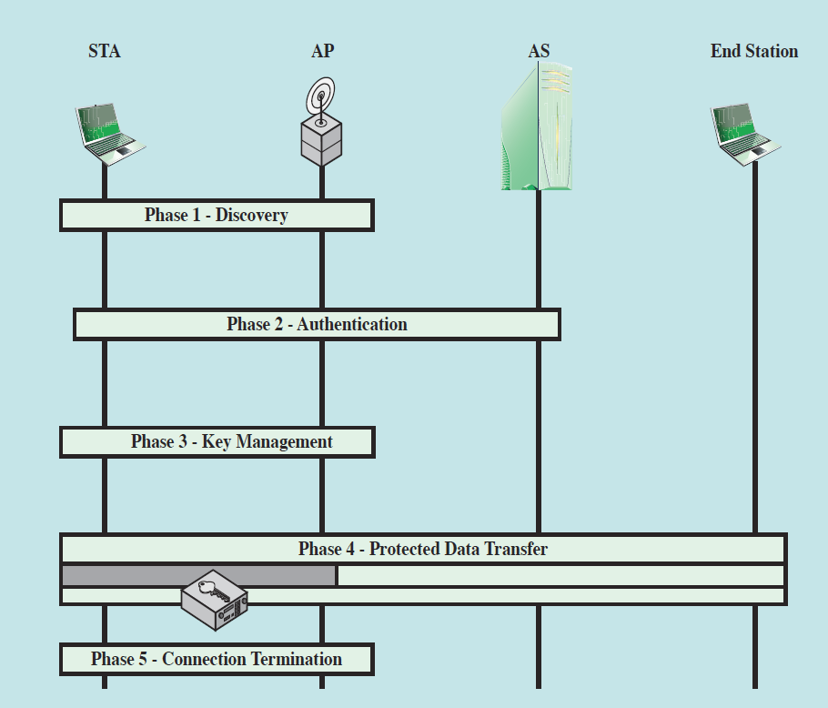
WPA2 Phases of Operation
Phase 1: The AP and the client agree on the security policy
Phase 2: Generate the master key
Phase 3: Creating temporary keys
Phase 4: All keys generated in phase 3 will be used by the CCMP protocol to provide data confidentiality and integrity

Slide 5
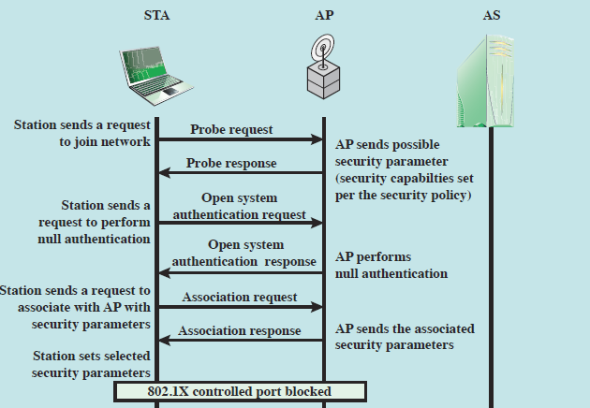
Phase 1: Discovery
Capability Discovery
Open System Authentication
Association

Slide 6
Capability Discovery
An AP uses messages called Beacons and Probe Responses to advertise its security capabilities
Advertised in an RSN Information Element (RSN IE)
The STA uses these to identify an AP for a WLAN with which it wishes to communicate
The STA associates with the AP, which it uses to select the cipher suite and authentication mechanism in Association Request

Slide 7
Open System Authentication
The purpose of this frame sequence, is simply to maintain backward compatibility with the IEEE 802.11 state machine
It provides no security
In essence, the two devices (STA and AP) simply exchange identifiers

Slide 8
Association
The purpose of this stage is to agree on a set of security capabilities to be used
The STA then sends an Association Request frame to the AP.
Specify one set of matching capabilities (one authentication and key management suite, one pairwise cipher suite, and one group-key cipher suite) from among those advertised by the AP

Slide 9
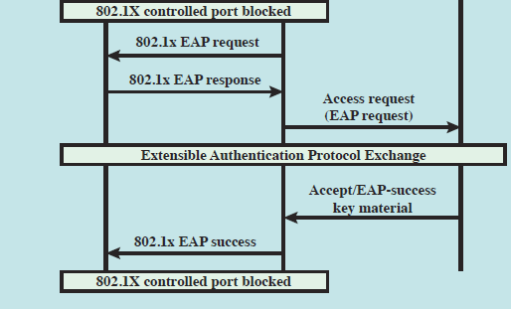
Phase 2: Authentication
This phase is based on EAP and the authentication method which has been agreed on in phase 1

Slide 10
Authentication Steps
Connect to AS
The STA sends a request to its AP that it has an association with for connection to the AS;
The AP acknowledges this request and sends an access request to the AS
EAP exchange
Authenticate the STA and AS to each other
Secure key delivery
Once authentication is established, the AS generates a master session key and sends it to the STA

Slide 11
EAP Exchange Process
Starts the 802.11X exchange with EAPOL-start message
Authenticator issues an EAP-request/identity frame
Supplicant replies with EAP-response/identity frame and passed to the radius server
Radius server determines the type of authentication required and sends an EAP-request for particular method type
The supplicant replies with an EAP-response/method frame
Steps 4 and 5 are repeated to complete the authentication
The radius server grants request with Radius-access-accept packet

Slide 12
Phase 3 Key Management
PMK – Pairwise Master Key
Sent from the AS to the Authenticator
Both the Supplicant and Authenticator now have the same PMK
PMK is permanent for the entire session
Must generate a Pairwise Transient Key for encryption of data.
Done using 4-way handshake

Slide 13
Four-Way Handshake
Confirm that the client holds the PMK.
Confirm that the PMK is correct and up-to-date.
Create pairwise transient key (PTK) from the PMK.
Install the pairwise encryption and integrity keys into IEEE 802.11.
Transport the group temporal key (GTK) and GTK sequence number from Authenticator to Supplicant and install the GTK and GTK sequence number in the STA and, if not already installed, in the AP.
Confirm the cipher suite selection.

Slide 14
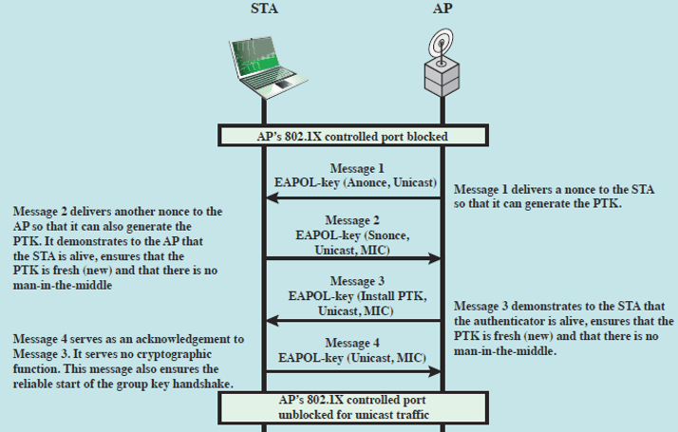
Four-Way Handshake
Notes:
The STA and AP use this handshake to confirm the existence of the PMK, verify the selection of the cipher suite, and derive a fresh PTK for the
following data session. The four parts of the exchange are as follows.
• AP → STA: Message includes the MAC address of the AP and a nonce (Anonce)
• STA → AP: The STA generates its own nonce (Snonce) and uses both nonces and both MAC addresses, plus the PMK, to generate a PTK. The STA then
sends a message containing its MAC address and Snonce, enabling the AP to generate the same PTK. This message includes a message integrity code (MIC)
using HMAC-MD5 or HMAC-SHA-1-128. The key used with the MIC is KCK.
• AP → STA: The AP is now able to generate the PTK. The AP then sends a message to the STA, containing the same information as in the first message,
but this time including a MIC.
• STA → AP: This is merely an acknowledgement message, again protected
by a MIC.

Slide 15
Pairwise Key Hierarchies
The PMK (Pairwise Master Key) derivation depends on what we have used on the authentication method
If we used PSK (Pre-Shared Key), then the PMK will be equal to PSK.
If we used an authentication server, then the PMK will be derived from the 802.1X authentication MK.
Pre-Shared Key (PSK)
Master Key (MK)
Pair-wise Master Key (PMK)
Pair-wise Transient Key (PTK)
Key Confirmation Key (KCK)
Key Encryption Key (KEK)
Temporal Key (TK)

Slide 16
64 bytes Pairwise Transient Key
16 bytes of EAPOL-Key Confirmation Key (KCK)
Used to compute MIC on WPA EAPOL Key message
16 bytes of EAPOL-Key Encryption Key (KEK)
AP uses this key to encrypt additional data sent (in the 'Key Data' field) to the client (for example, the RSN IE or the GTK)
16 bytes of Temporal Key (TK)
Used to encrypt/decrypt Unicast data packets

Slide 17
WPA2 Encryption
The primary enhancement over WPA is the use of the AES (Advanced Encryption Standard) algorithm.
128 bit AES using the Counter-Mode/CBC-MAC Protocol (CCMP)
CCMP
CTR
CBC-MAC

Slide 18
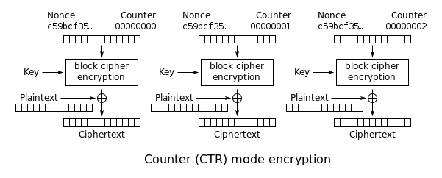
Counter Mode Encryption
The encryption service in WPA2 is based on the AES algorithm used in the CTR mode.
It generates the next keystream block by encrypting successive values of a "counter"
Notes:
The encryption service in WPA2 is based on the AES algorithm used in the CTR mode.

Slide 19
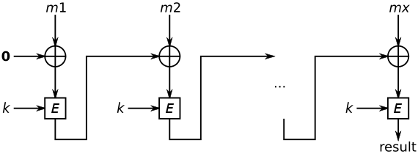
Cipher Block Chaining (CBC) - MAC
In WPA2, the data integrity check is carried out by computing the CBC-MAC message authentication code
XOR each 128- bit block of the data with the AES encrypted value as obtained from the previous 128-bit block

Slide 20
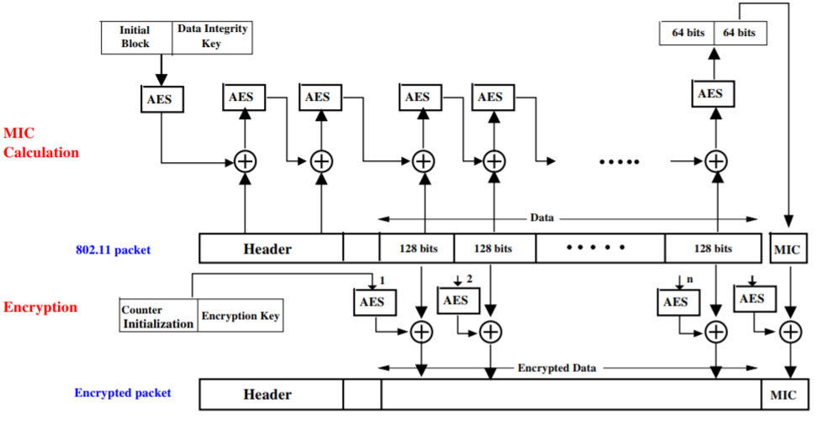
Counter-Mode/CBC-MAC Protocol (CCMP)

Slide 21
AES – CCMP Features
CCMP provides integrity protection over both the frame body and nearly the entire header in a MAC frame,
which prevents an adversary from exploiting the MAC headers
CCMP uses a 48-bit Packet Number (PN)
to prevent replay attacks and construct a fresh nonce for each packet
Analysis suggests that once CCMP is implemented,
an adversary will not able to break the data confidentiality and integrity without the knowledge of the key

Slide 22
Encryption Method Comparison
 | WEP | WPA | WPA2
Cipher | RC4 | RC4 | AES
Key Sizes | 40 bits | 128bits encryption 64 bits authentication | 128 bits
Key Life | 24 bit IV | 48 bit IV | 48 bit IV
Packet Key | Concatenated | Mixing Function | Not Needed
Data Integrity | CRC-32 | Michael Algorithm | CCM
Header Integrity | None | Michael Algorithm | CCM
Defeat Replay Attacks | None | IV Sequence | IV Sequence
Key Management | None | EAP Based | EAP Based

Slide 23
WPA2 Pros
The WPA2 has immunity against many types of hacker attacks, like:
Man-in-the-middle.
Authentication forging.
Replay.
Key collision.
Weak keys.
Packet forging.
Brute–force/dictionary attacks.

Slide 24
WPA2 Pros (cont.)
WPA2 adds two enhancements to support fast roaming as follow:
Allow the client to reconnect to the access points which he has recently been connected to without needing to re-authenticate because of the PMK caching feature.
Allow the client to pre-authenticate himself with the access point which he is moving toward while he is still connected to the access point which he is moving away from.

Slide 25
WPA2 Cons
Like all Wi-Fi security standard, the WPA2 can't stand in front of the physical layer attacks like:
RF jamming.
Data flooding.
Access points failure.

Slide 26
WPA2 Cons (cont.)
The attacker can get and discover lots of network information by analyzing the unprotected control and management frames.
It is vulnerable for the DoS attack.
It is vulnerable to the MAC addresses spoofing and the mass de-authentication attacks.

Slide 27
The KRACK Attack
KRACK is short for Key Reinstallation Attack
The attack uses vulnerabilities in the 4-way handshake of the current WPA- 2 protocol.
Threat level : Pretty bad – All Wi-Fi routers everywhere are vulnerable

Slide 28
The 4-way handshake
Used to connect to any protected Wi-Fi network
Two main purposes:
Mutual authentication
Negotiate fresh PTK: pairwise temporal key
Appeared to be secure:
No attacks in over a decade (apart from password guessing)
Proven that negotiated key (PTK) is secret
And encryption protocol proven secure

Slide 29

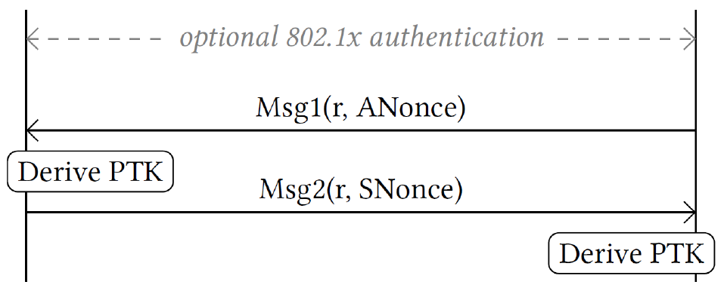
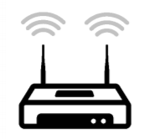
4-way handshake (simplified)
PTK = Combine(shared secret,
ANonce, SNonce)

Slide 30
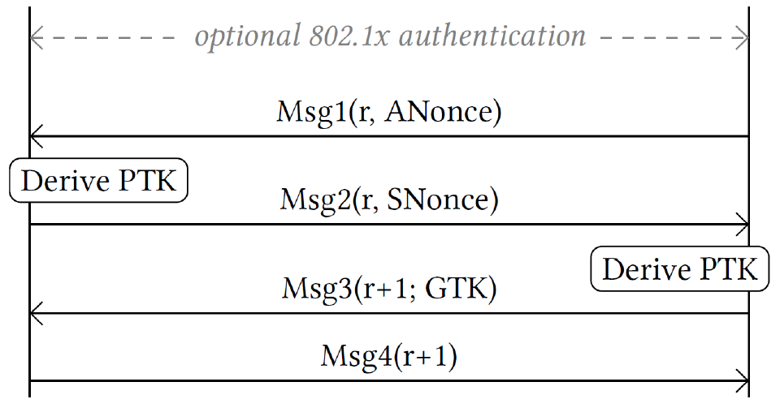
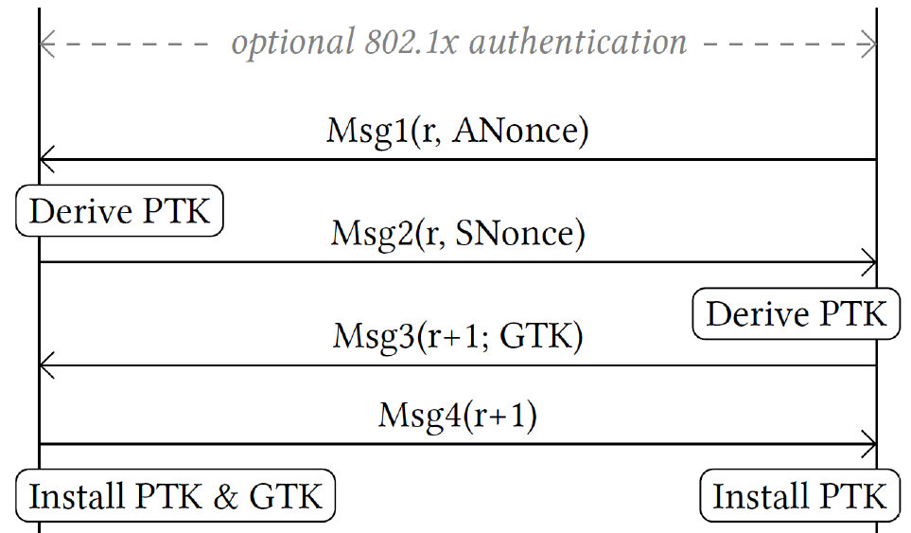
4-way handshake (simplified)
PTK is installed

Slide 31
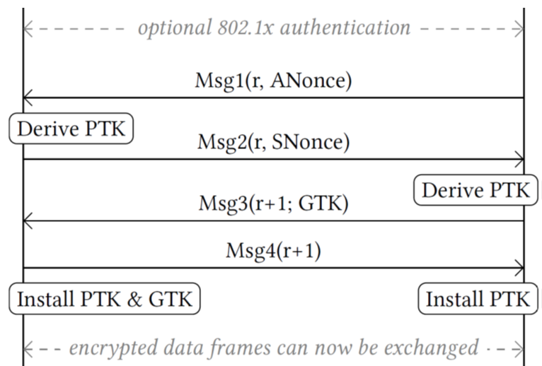
The Key Reinstallation Attack on WPA2

Slide 32
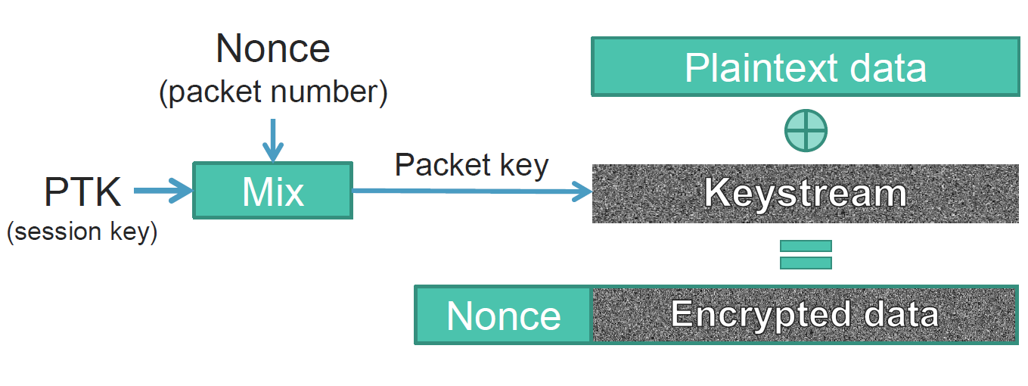
Frame encryption (simplified)
Nonce reuse implies keystream reuse (in all WPA2 ciphers)

Slide 33
4-way handshake (simplified)
Installing PTK initializes nonce to zero

Slide 34

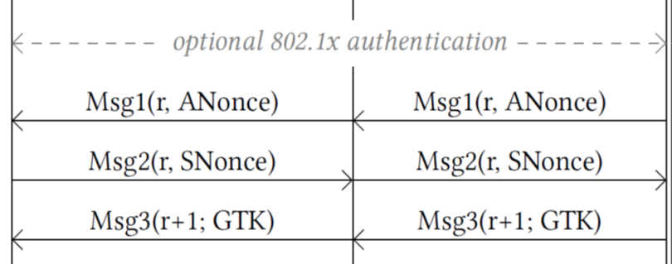
Reinstallation Attack

Slide 35
Reinstallation Attack
Block MSG4

Slide 36
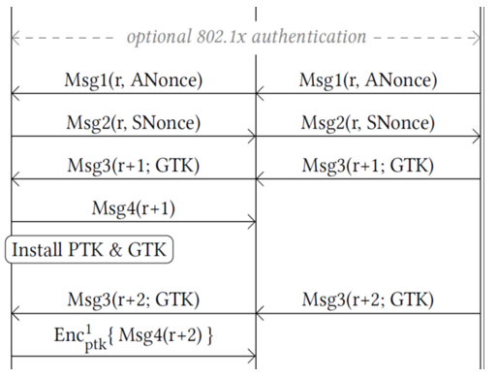
Reinstallation Attack
Because PTK has been installed
Msg4 is now encrypted

Slide 37
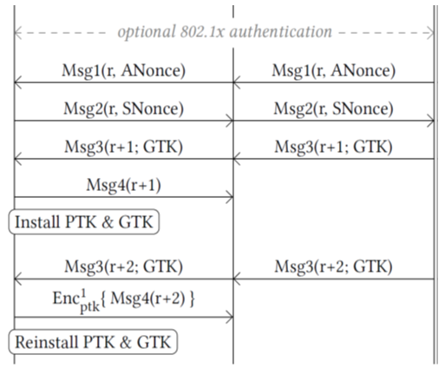
Reinstallation Attack
Key Reinstallation!
Nonce is reset

Slide 38
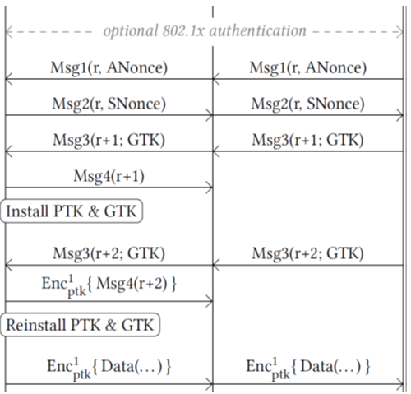
Reinstallation Attack
Same nonce is used

Slide 39
Reinstallation Attack
Keystream
Decrypted Data

Slide 40
Key Takeaway
Limitations of formal proofs:
WPA 4-way handshake has proven to be secure
Encryption ciphers have been mathematically proven to be secure
Combination is not proven secure
Enterprise PMK was just as vulnerable as Personal pre-shared keys.
Creates a false sense of security.
Abstract model ≠ real code
Must assure code matches specification

